Slide 1







T-SQL - Beyond the Basics
Barney Lawrence
He/Him
Senior Business Intelligence Developer
Jet2.com

Slide 2




Barney
Lawrence
He/Him
Senior BI Developer
Barney Lawrence has over a decade's experience helping people make the most of their data on Microsoft platforms. Having moved from the guy who knows Excel, to Data Analyst, to Accidental BI Developer and finally to Actual BI Developer, he currently works as a Senior BI Developer and Team Lead for Jet2.com
Jet2.com
@SQLBarney
barneylawence.com
linkedin.com/in/barneylawrence/

Slide 3





About Me

Slide 4

Why

Slide 5

Content
SSMS Tips and Tricks
Common Table Expressions
Apply Operator
Window Functions
Pivoting
Unpivoting
Putting It All Together

Slide 6

SSMS - Options

Slide 7
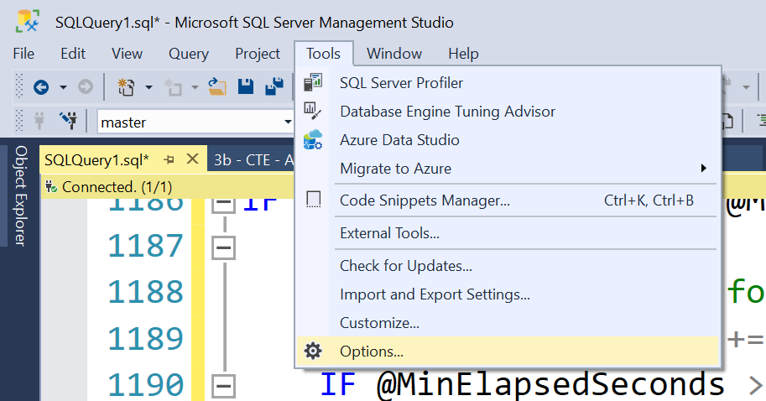

Slide 8
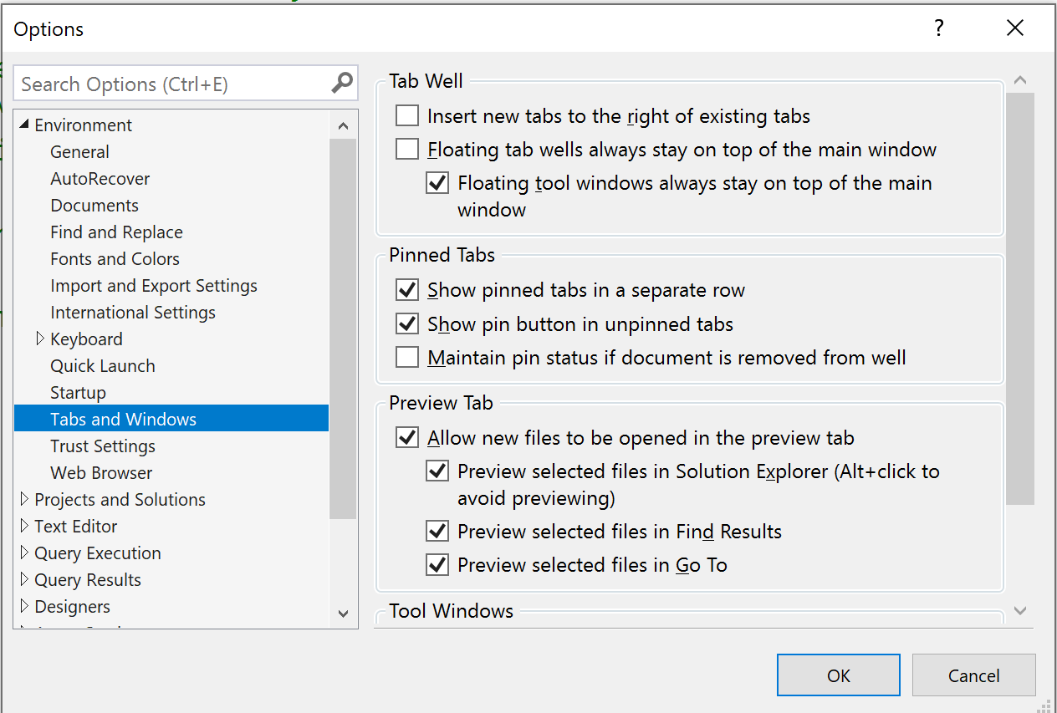

Slide 9
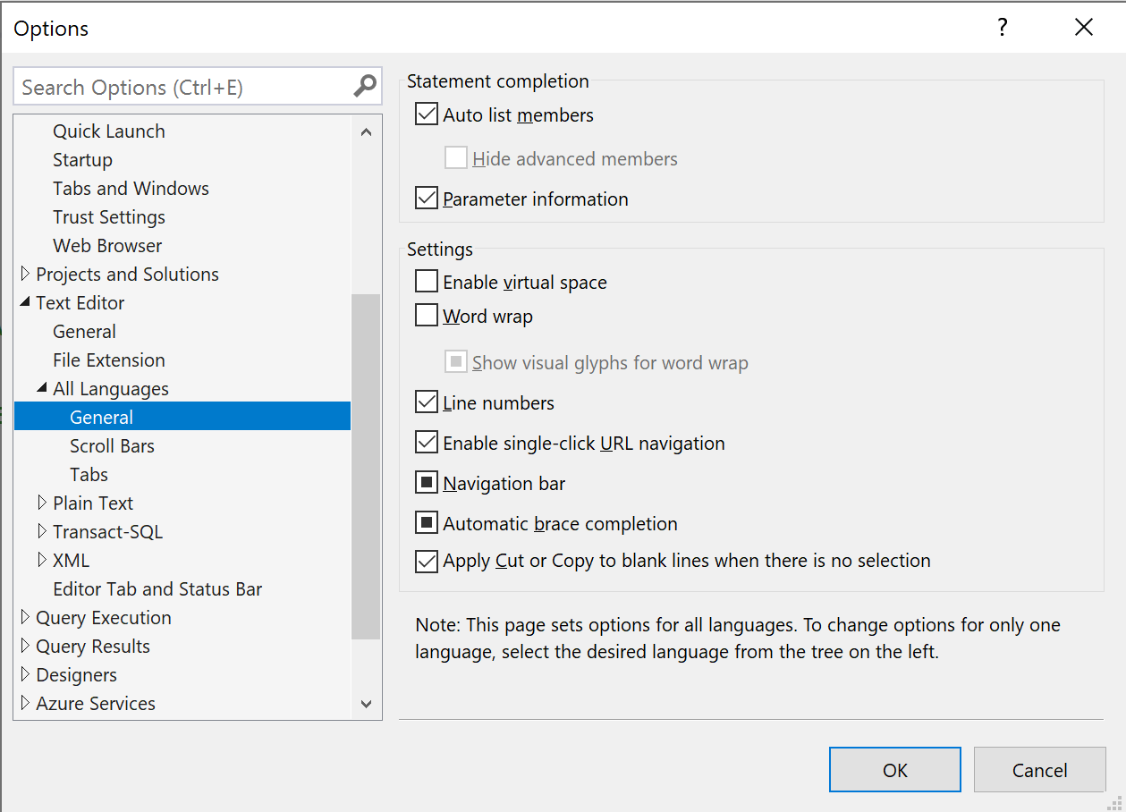

Slide 10
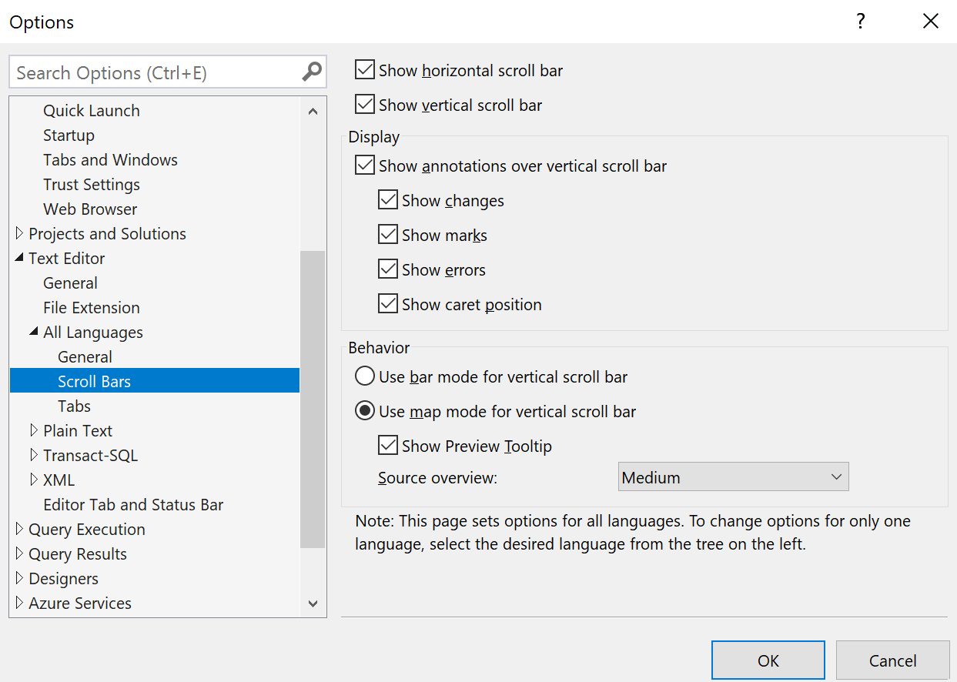

Slide 11
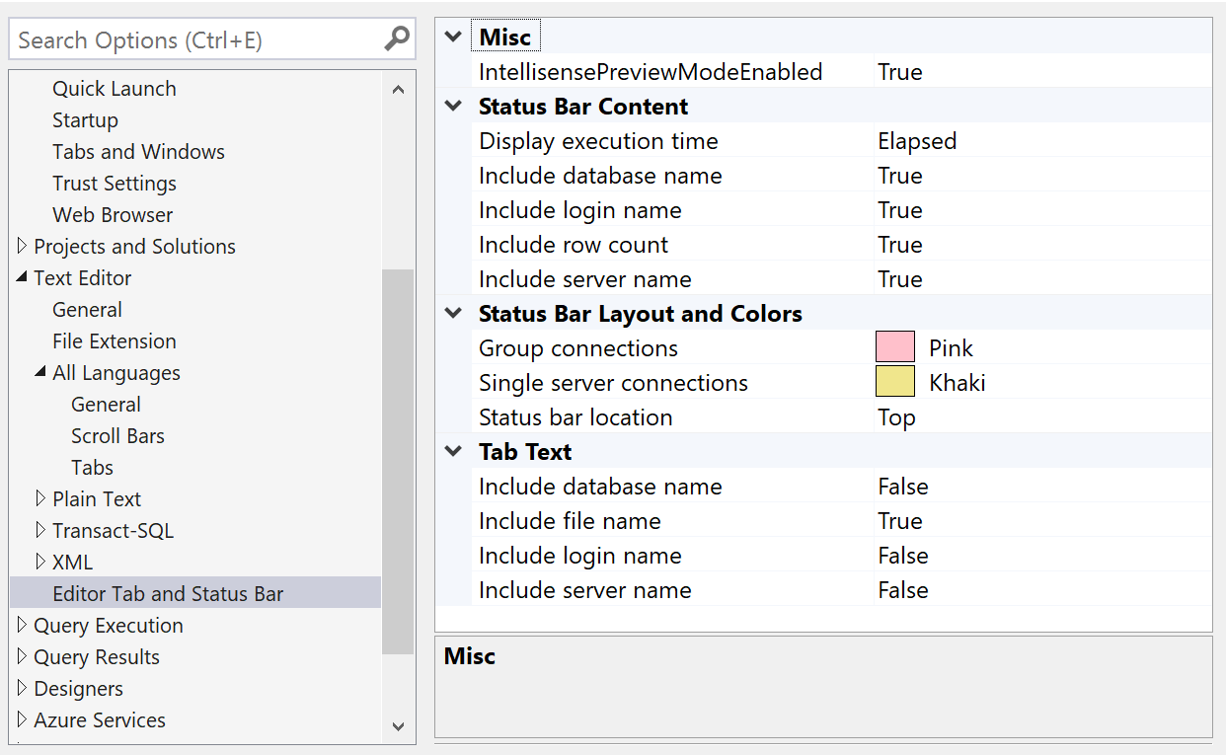

Slide 12
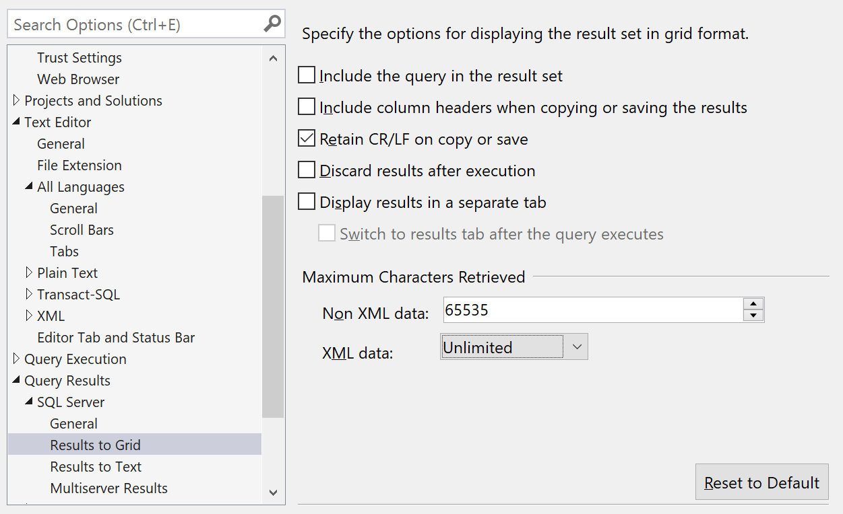

Slide 13
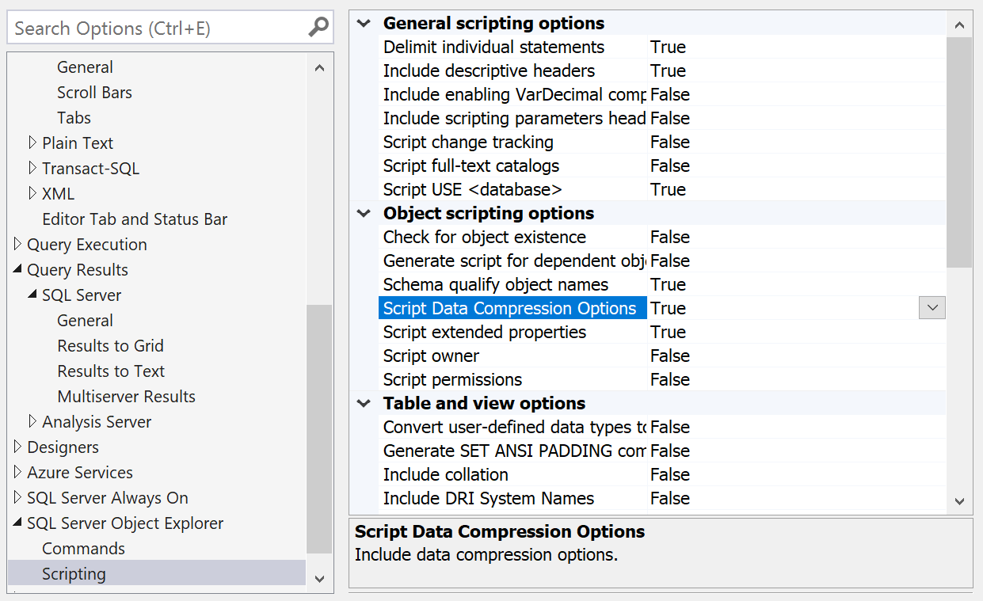

Slide 14

SSMS - Custom Keyboard Shortcuts

Slide 15
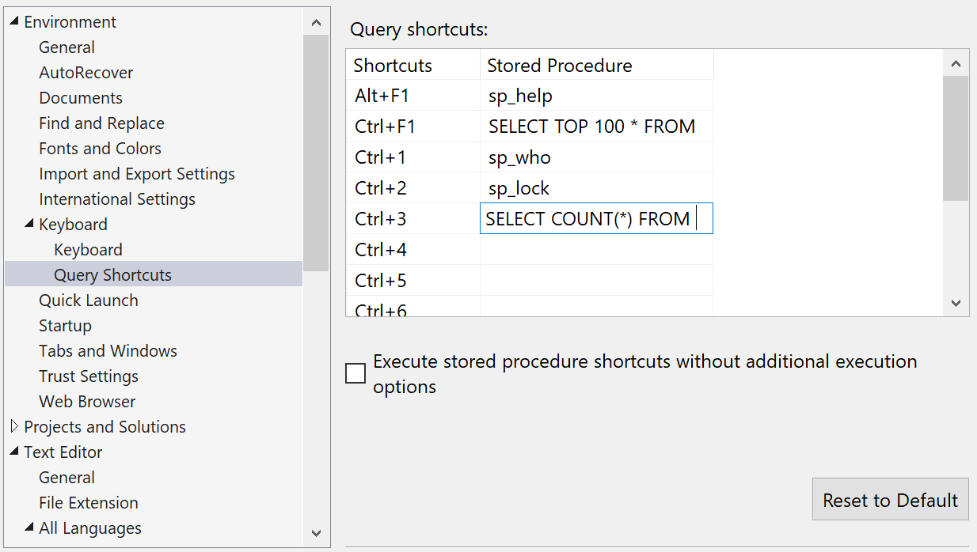

Slide 16
SSMS – Alt Key

Slide 17
Common Table Expressions (CTEs)

Slide 18
APPLY
CROSS APPLY
OUTER APPLY

Slide 19
Window Functions

Slide 20
Pivoting Data
Value 1 | Value 2 | Value 3
Value 1
Value 2
Value 3

Slide 21
Unpivoting Data
Value 1 | Value 2 | Value 3
Value 1
Value 2
Value 3

Slide 23


github.com/BarneyLawrence/Sessions-TSQL-BeyondTheBasics
@SQLBarney
barneylawence.com
linkedin.com/in/barneylawrence/

